Slide 1
Neighborhood-based analysis of self-organizing maps
Tyler J Burns, Ph.D.
AG Mei at German Rheumatism Research Center

Slide 2

Exploring the visual capabilities of large self-organizing maps

Slide 3
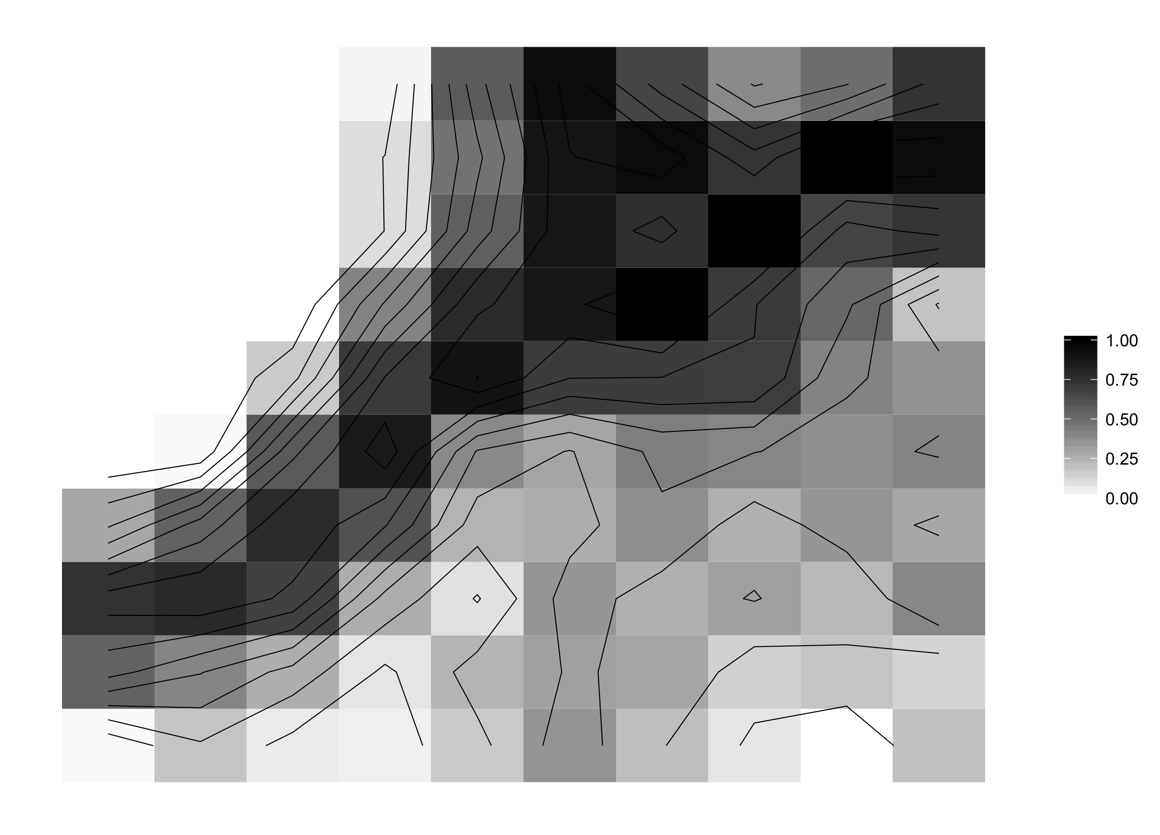
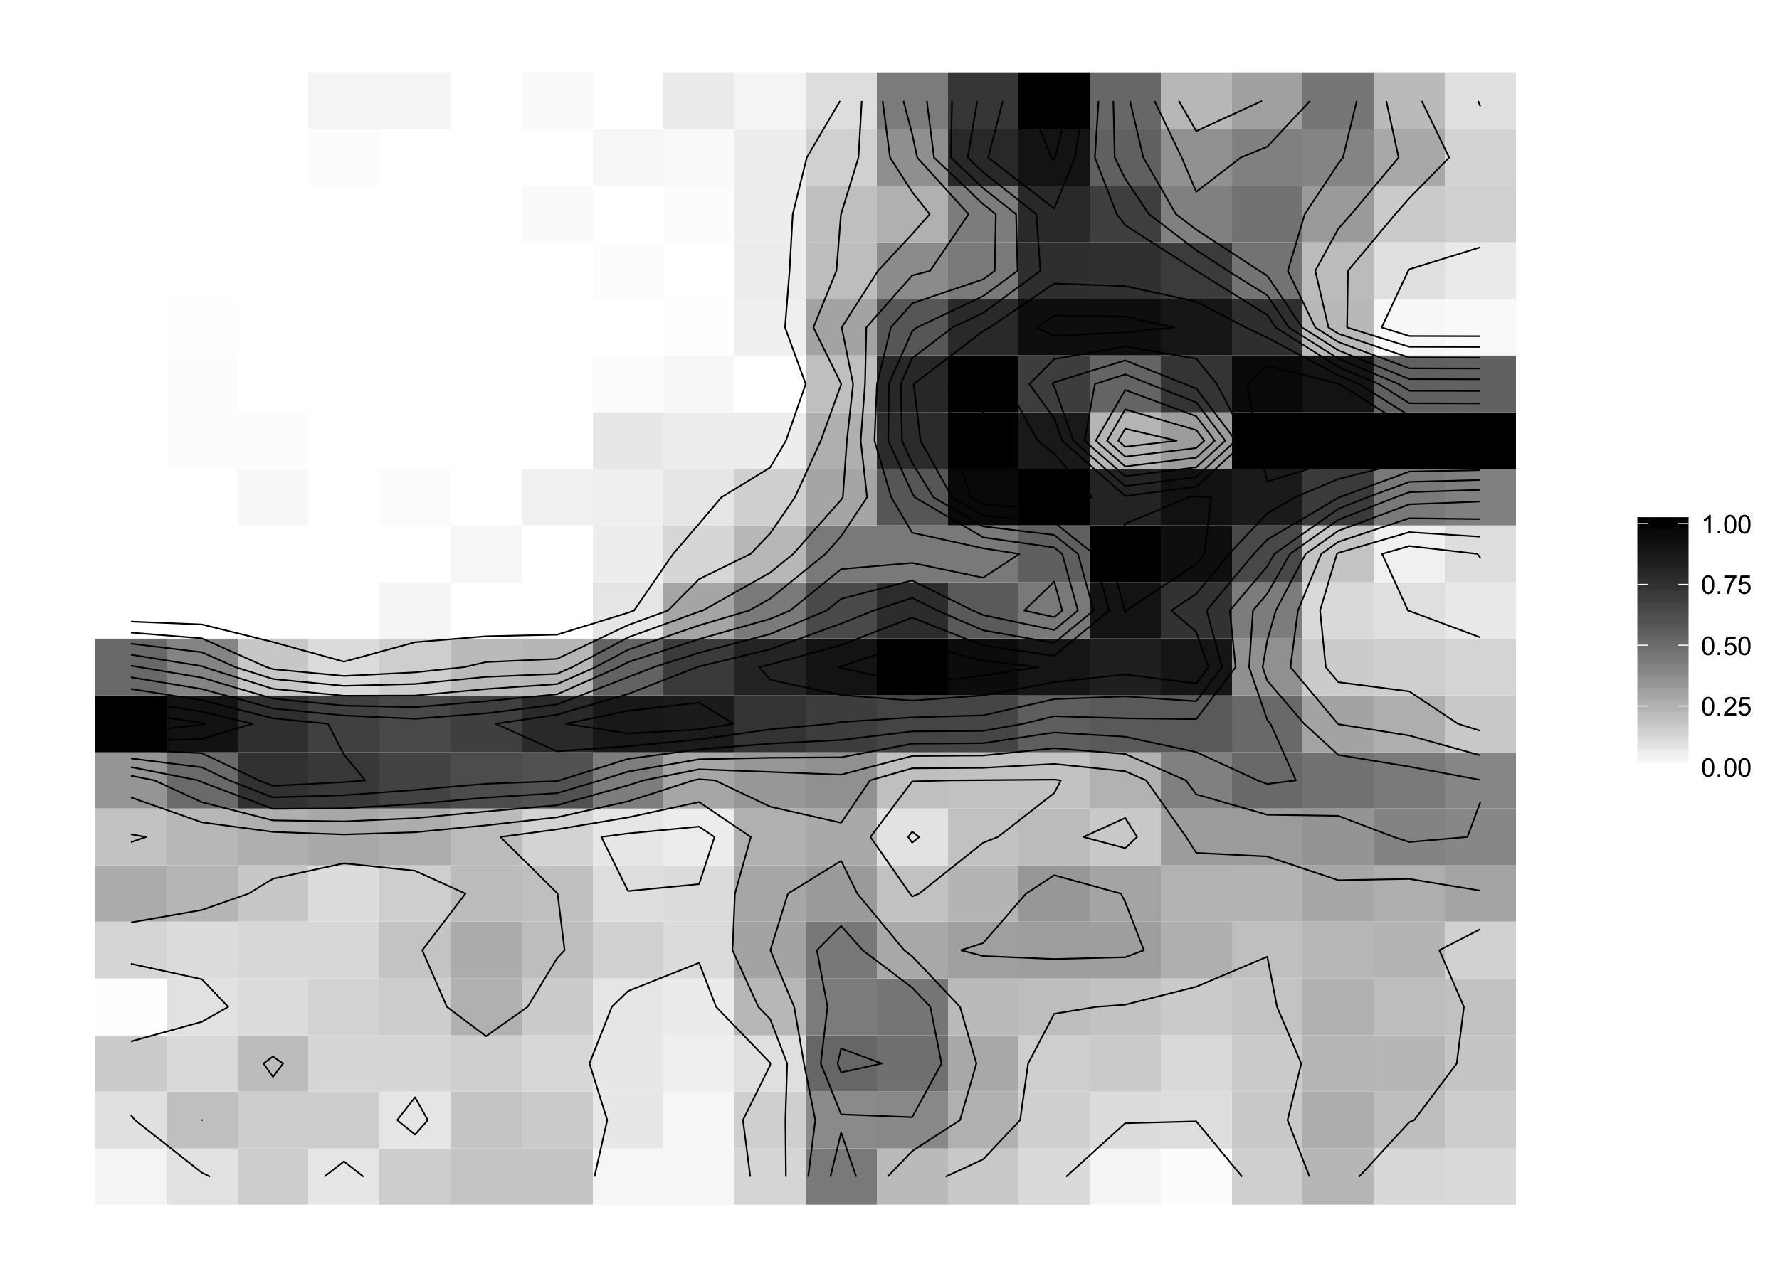
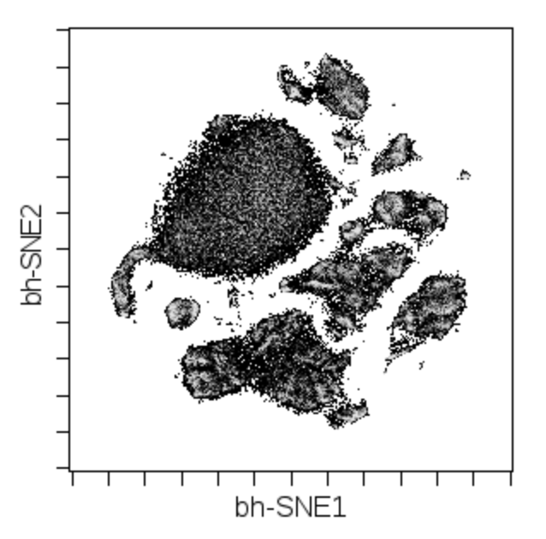
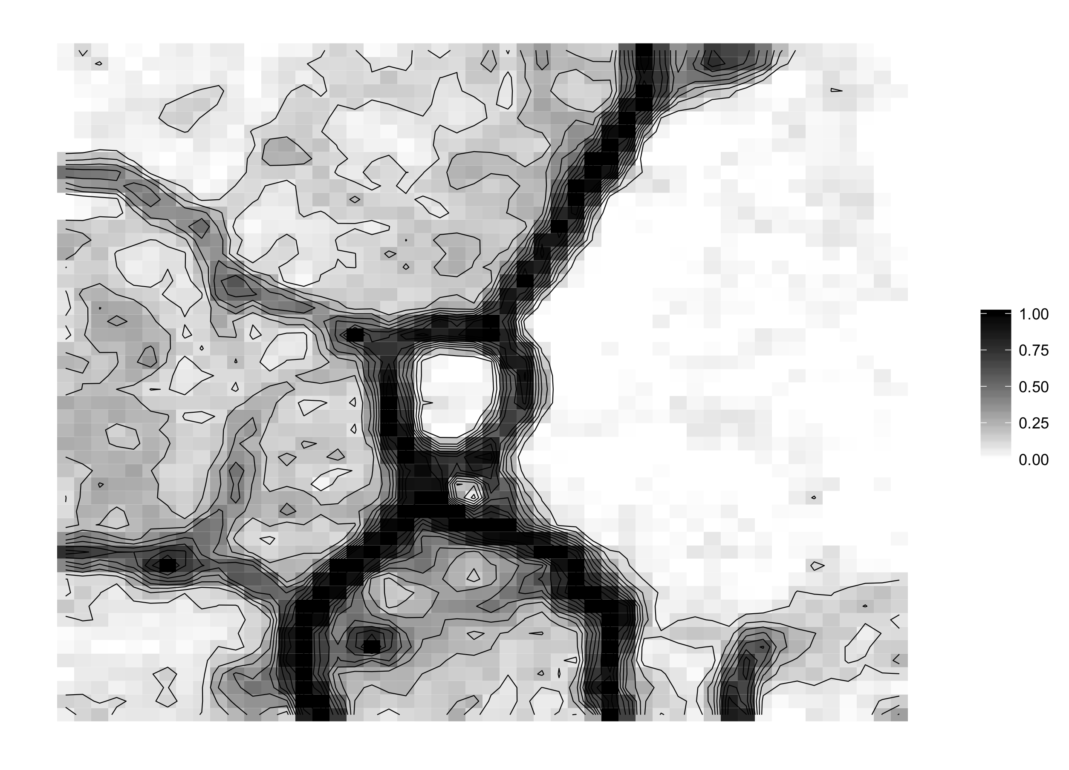
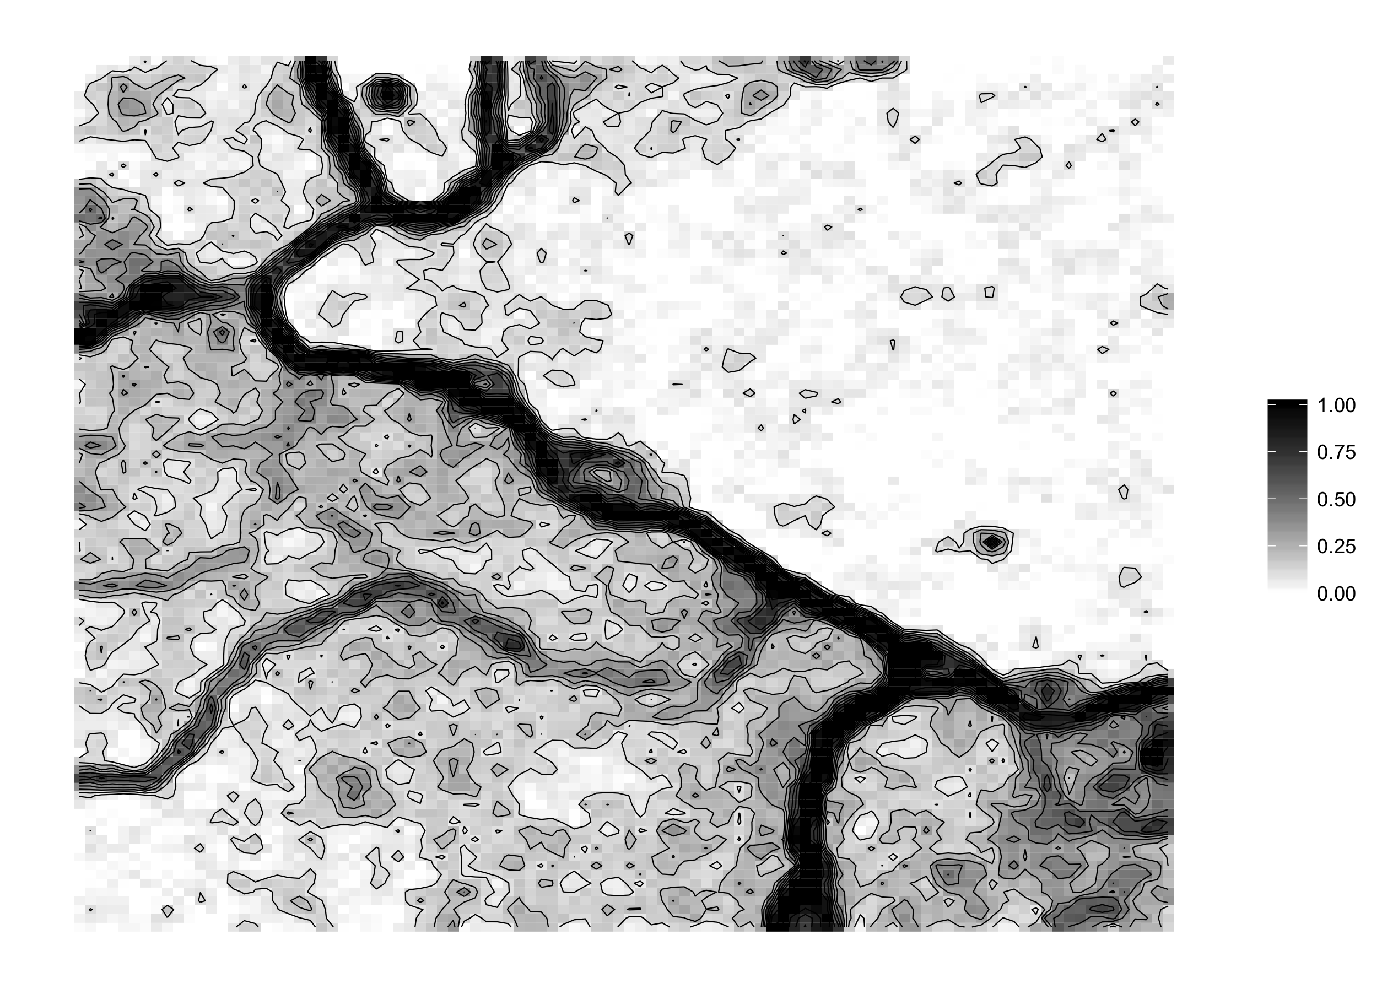
U-Matrix visualizations reveal dataset complexity in a manner much different than t-SNE
t-SNE map
10 x 10
(Flow-
SOM
default)
20 x 20
Data type: Mass cytometry
Dims: 42, surface markers
Cell type: PBMCs
Cells: 100,000
50 x 50
100 x 100

Slide 4
Hypothesis: there are regions of the self-organizing map that are not populated
????????
Method:
Color the SOM by number of cells per node (average should be 10).
Threshold by 0 and greater than 0 cells

Slide 5
The majority of the SOM is populated with at least one cell
U-Matrix
Abundance
0-1 Thresholded Abundance
SOM size: 100 x 100
Data type: Mass cytometry
Dims: 42, surface markers
Cell type: PBMCs
Cells: 100,000

Slide 6
Hypothesis: distinct regions of the SOM are defined by distinct markers
Method:
Color the SOM by the marker
expression levels at each node
Compare these types of patterns
to that of a t-SNE map, the “best
practices” visualization scheme for
CyTOF data.
T cells???
CD3
CD4
CD8
Monocytes???
CD14
CD16

Slide 7
Marker expression patterns are concordant with the U-Matrix
U-matrix
CD14
CD16
CD3
CD4
CD8
CD11c
CD7
CD56
CD20

Slide 8
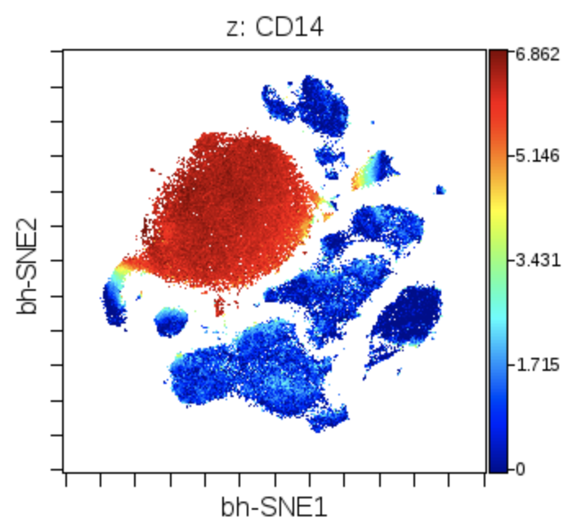
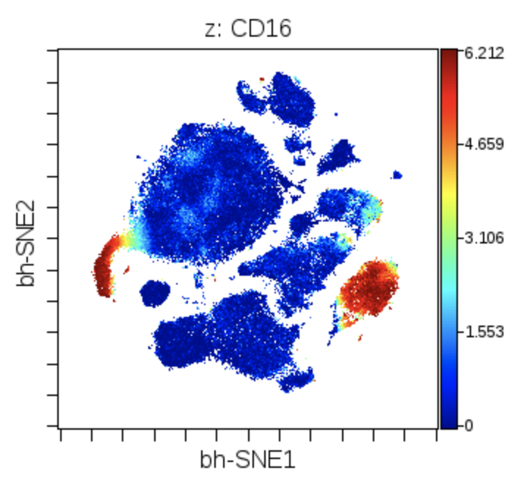
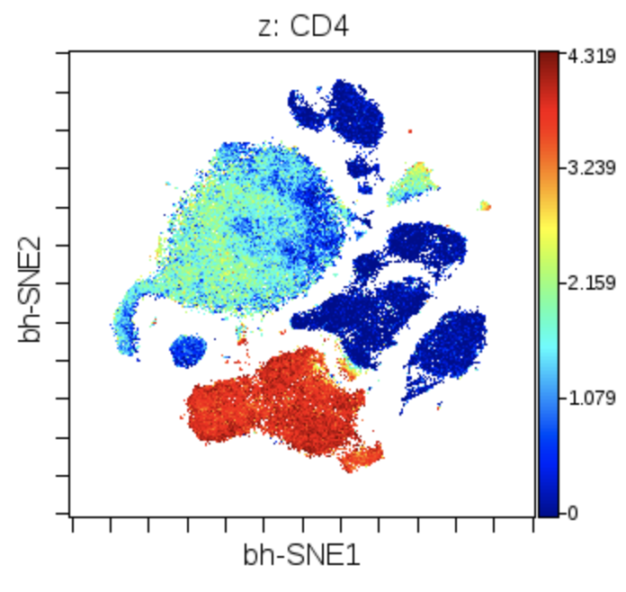
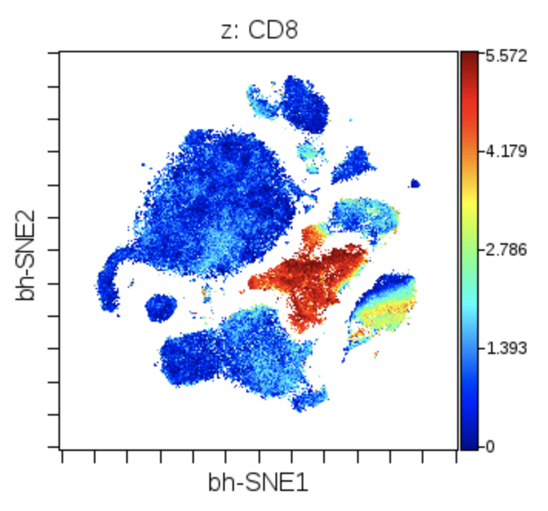
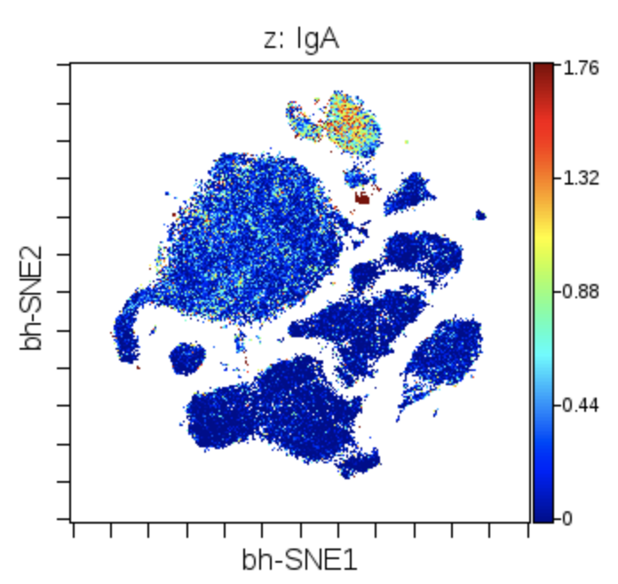
SOM vs t-SNE: colors of marker expression
CD14
CD16
CD4
CD8
IgA

Slide 9
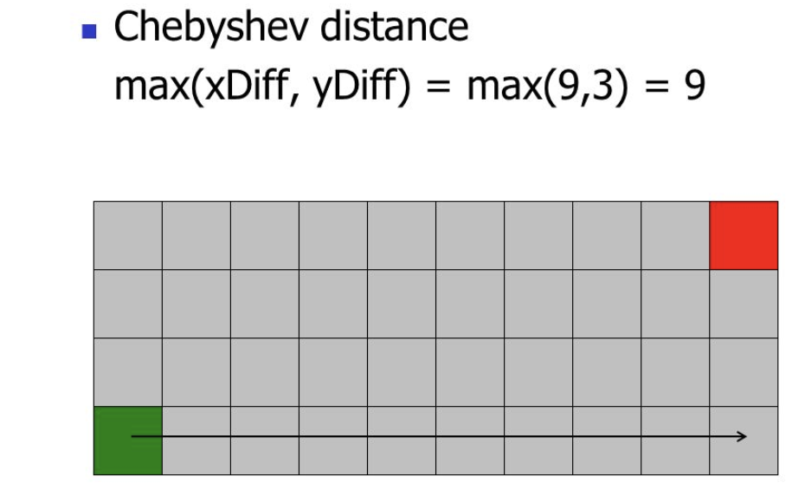
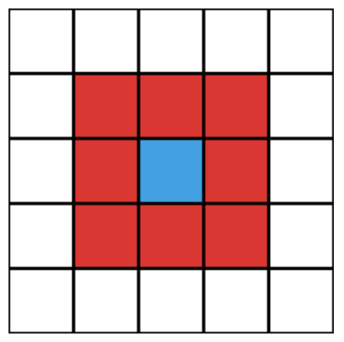
Hypothesis: U-matrix patterns could be brought out by analyzing Chebyshev distance between nodes
U-matrix
CD14
CD16
I don’t see this boundary
in the U-matrix!!
Method 1:
Calculate U-matrix with
Chebyshev
distance
Method 2:
Use the max
not the mean
of all distances in the Moore neighborhood

Slide 10
U-matrix visualization with alternate distance and neighbor aggregation functions
Euclidean mean
Euclidean max
Chebyshev mean
Chebyshev max

Slide 11
Hypothesis: Meta-clustering will draw boundaries in concordance with the U-matrix
Cluster 1
Method:
Perform hierarchical clustering on the
SOM nodes based on their marker expression
2) Visualize the meta-clusters on the map
itself to compare with the U-matrix
Cluster 2
Cluster 3
…

Slide 12
Color of U-Matrix by identity of the meta-clusters
U-matrix
2 clusters
5 clusters
10 clusters
20 clusters
50 clusters
100 clusters
500 clusters

Slide 13

Hypothesis: The Moore neighborhood distance averages provides similar information to the KNN distance averages

Slide 14
U-Matrix versus KNN-density estimation for SOM
U-matrix
k = 1
k = 10
k = 50
k = 100
k = 200
k = 500
k = 1000

Slide 15
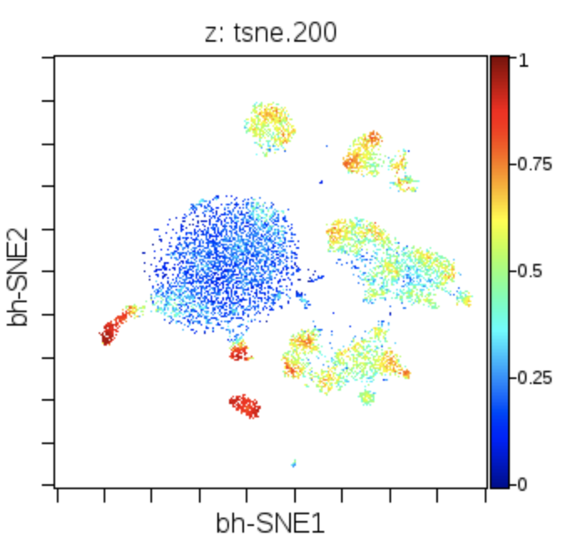
Hypothesis: U-matrix positioning fidelity more closely approximates the manifold locally than t-SNE positioning
High
fidelity???
Method:
Perform KNN
with K = 8 on
marker expression
per-node
Compare KNN
ID with the Moore
Neighborhood ID
Low
fidelity
Low
fidelity???
High fidelity

Slide 16
U-matrix fidelity: detecting topology of the SOM
Similarity of Outer Moore Neighborhood vs
KNN with K of 8
U-matrix

Slide 17

Hypothesis: Emergent self-organizing map (more nodes than number of cells) will provide helpful visualization for users
Method:
Train a 1000 x 1000
SOM on 10,000 cells.
This makes 100 nodes for
every cell.
(Runtime: 5 hours!)
2) Visualize the U-matrix,
and cell occupancy

Slide 18
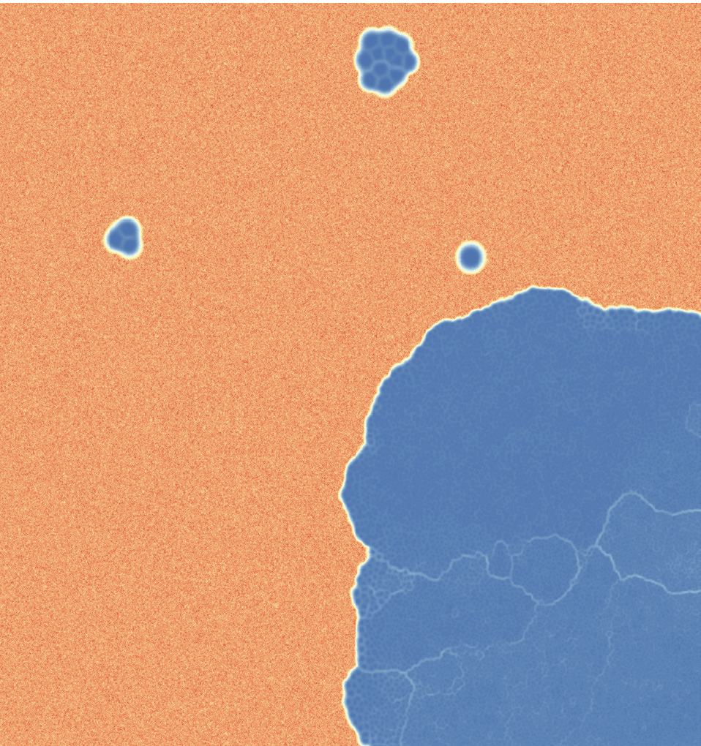
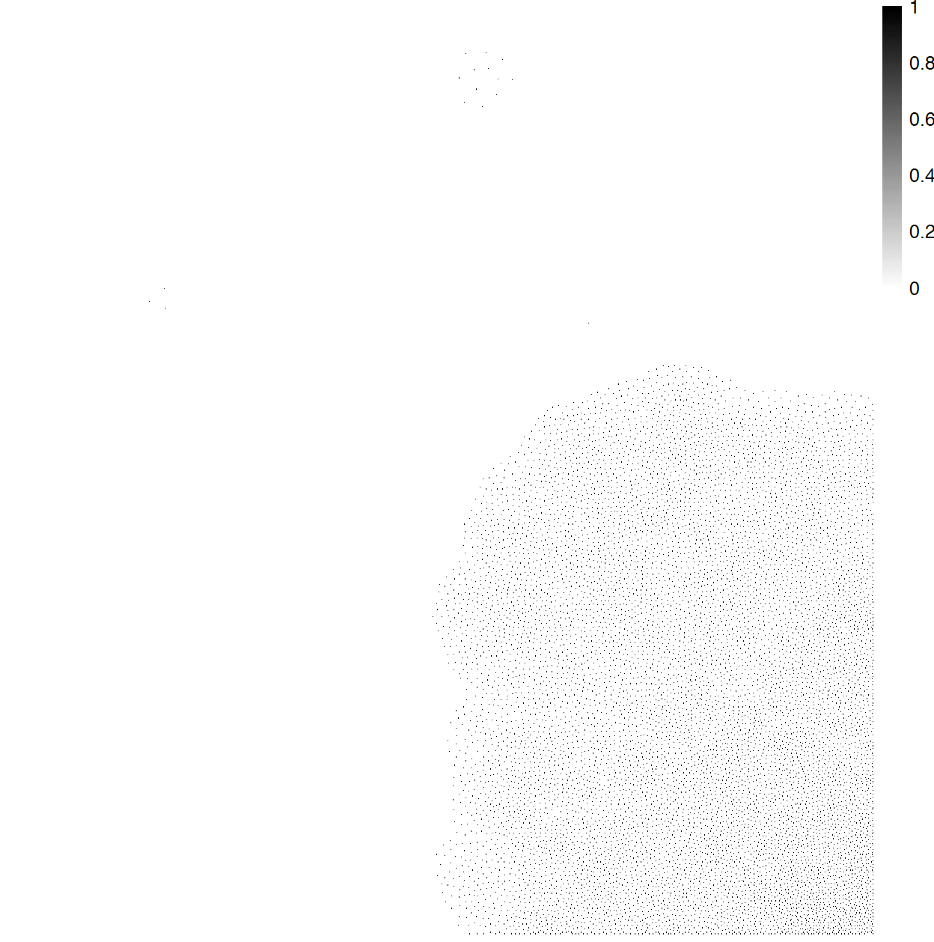
U-matrix and cell abundance profile of ESOM…still needs to be optimized
U-matrix
Abundance

Slide 19
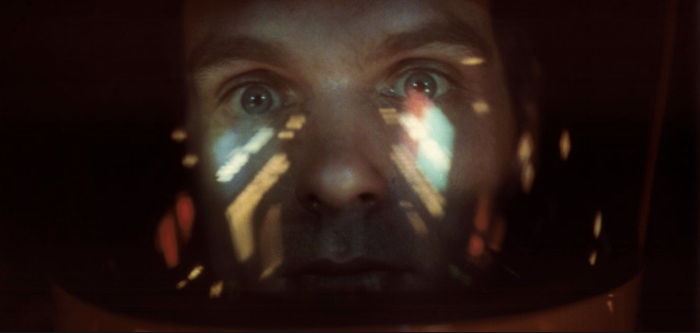
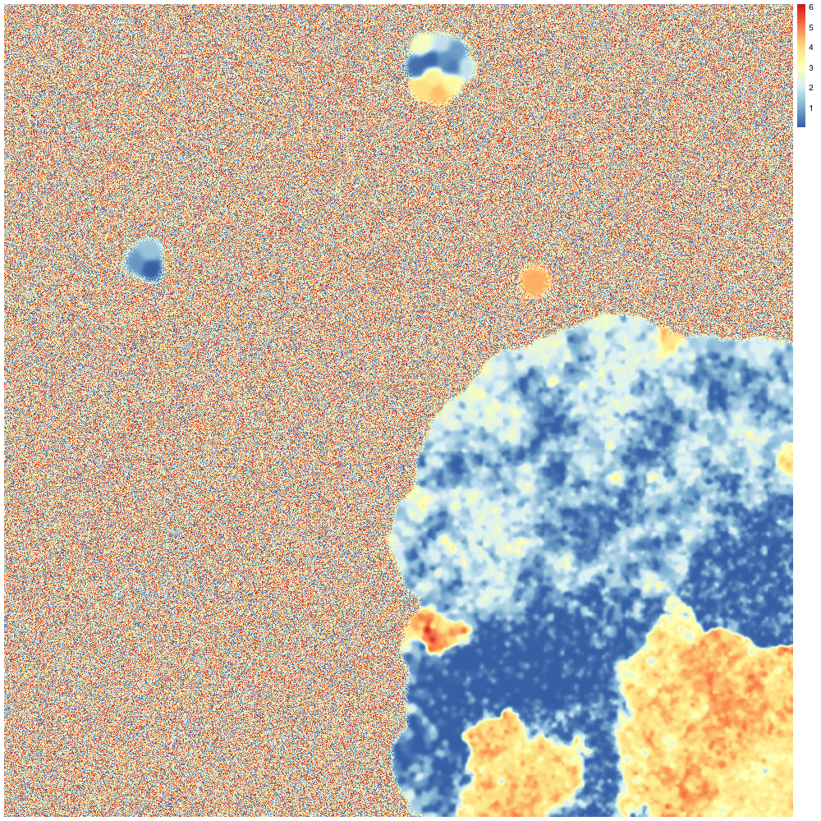


2001: A Marker Space Odyssey

Slide 20
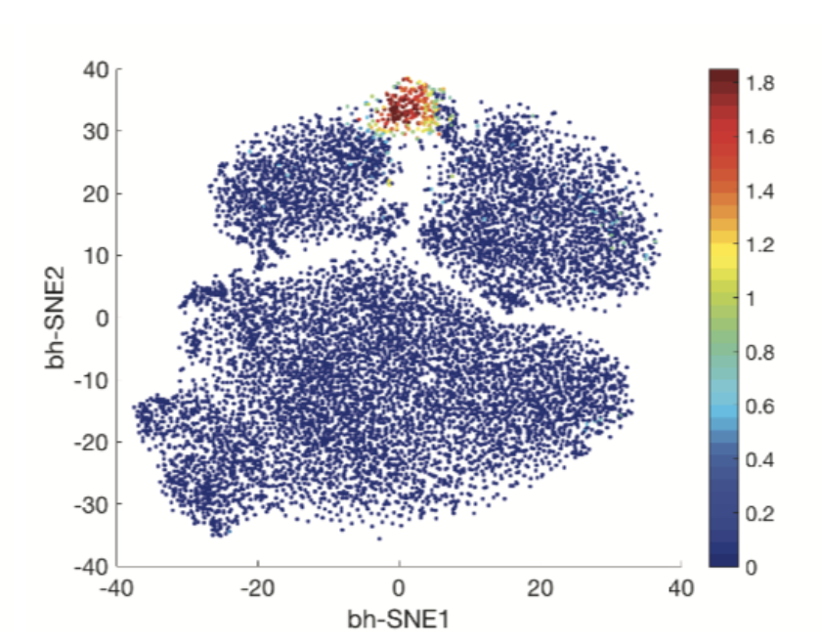
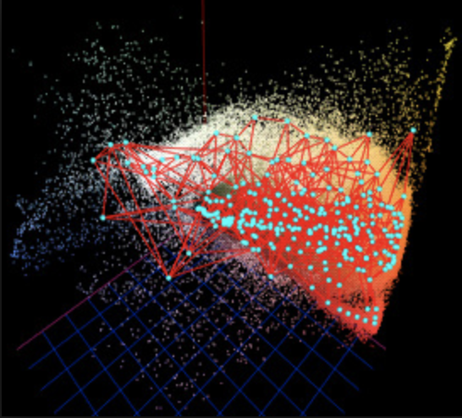
Future directions
Explore the use of U-Matrix visualizations on trajectory-based datasets
Compare the results I have with that of a growing neural gas, or hierarchical SOM

Slide 21
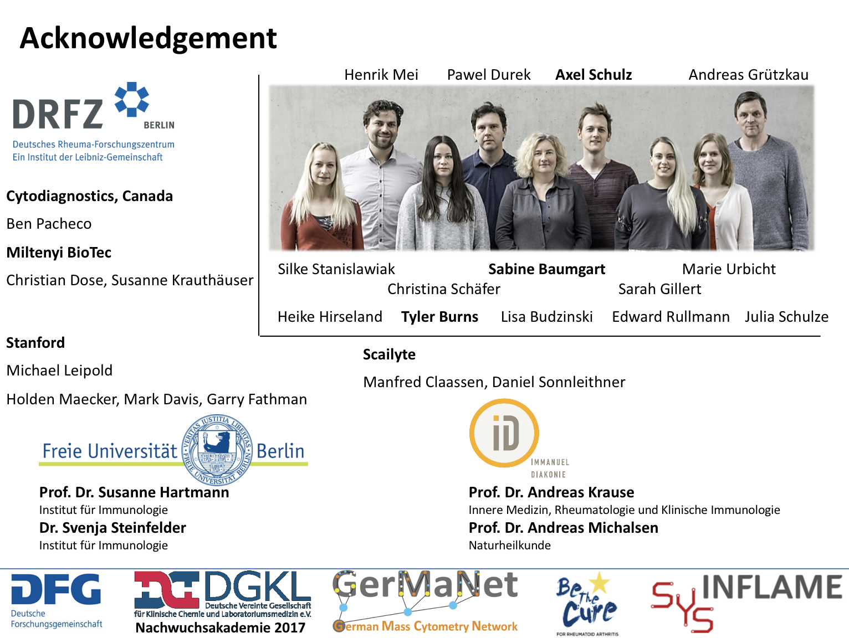
Notes:
And with that, here are my acknowledgements, with especially a huge thanks to Henrik for helping me make the big transition from the USA to Germany. It’s been a long road, but it has REALLY been worth it.

